Slide 1
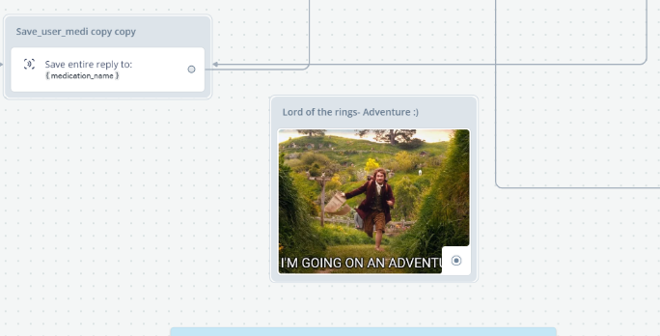
Addendum: Chatbot adventures ☺

Slide 2
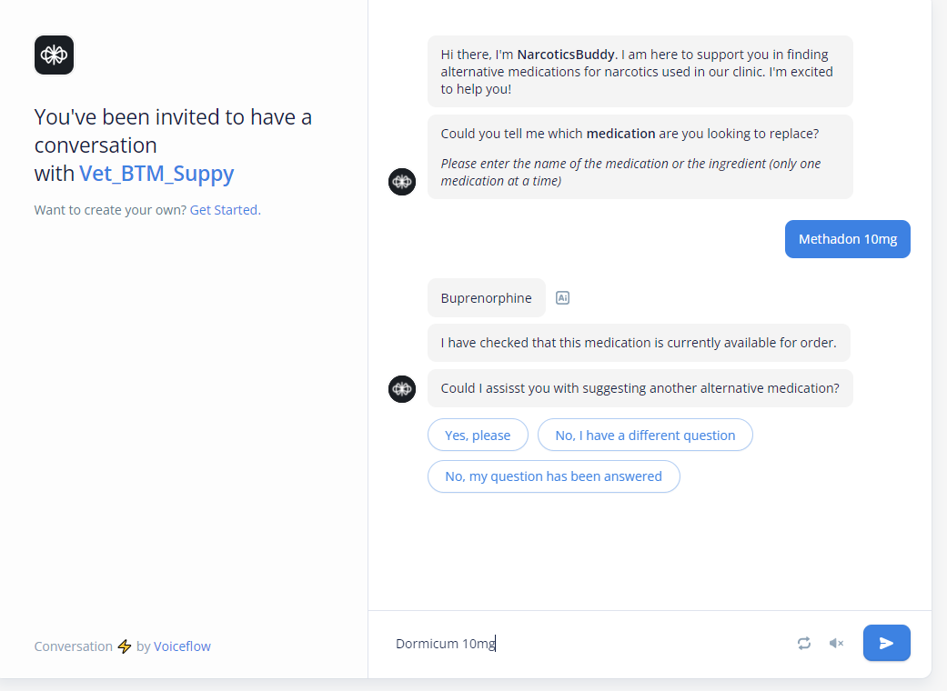
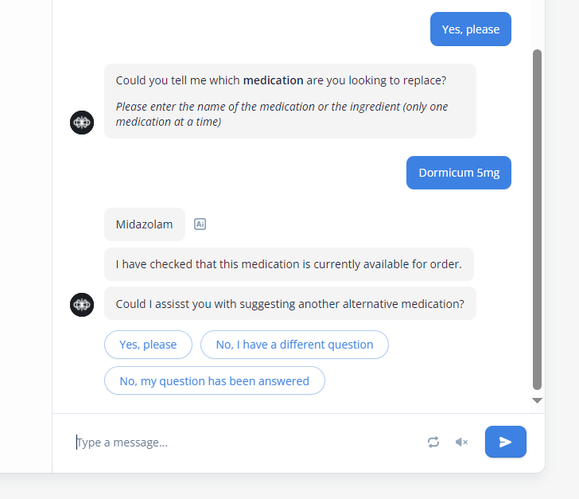
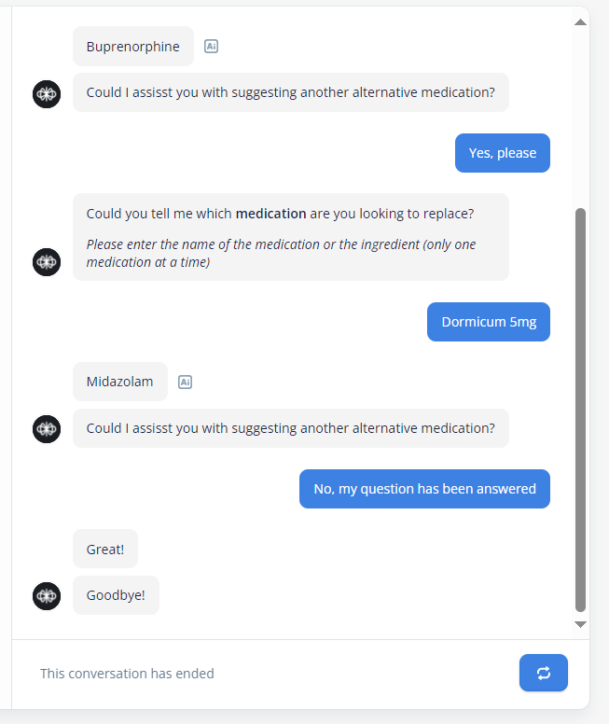
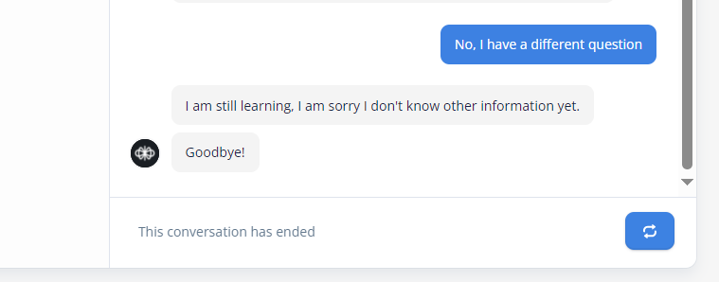

Slide 3
We initially explored the option to implement a chatbot to give the narcotics team the possibility to chat and get a suggestion for an alternative medication.
In this process we faced some issues however, and ultimately after a longer discussion with both Charuta and Devid during the course of different coachings, we decided to leave this idea, but we briefly wanted to illustrate what we did here.
We learned a lot regarding voiceflow, chatbot implementation and a lot of the «details» in setting up such a chatbot. ☺ It was a really interesting exploration of the topic
Creating, adapting and following the «conversation» framework was really interesting!

Slide 4
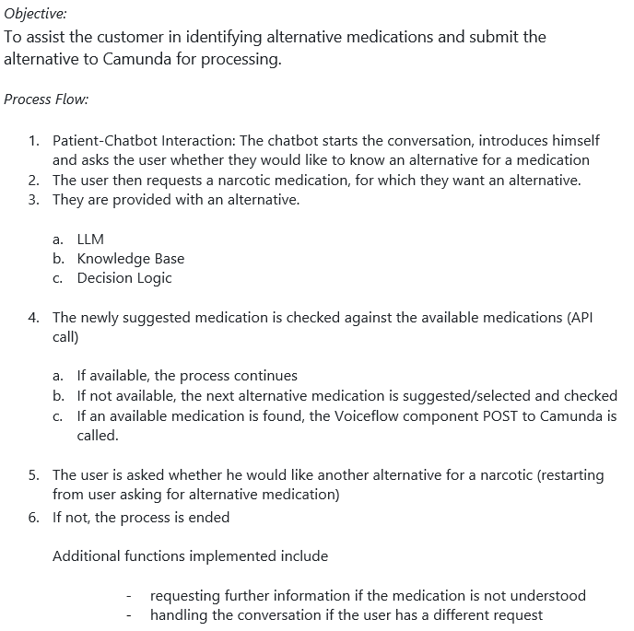
Some successes, some challenges

Slide 5
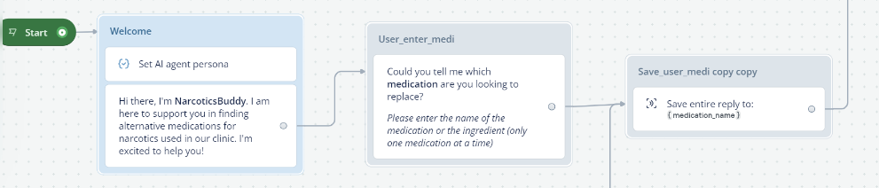
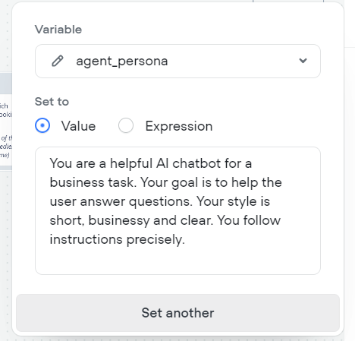
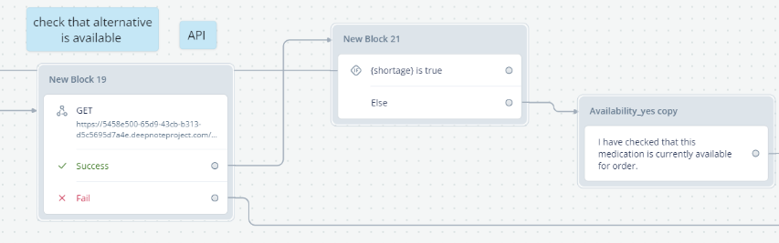
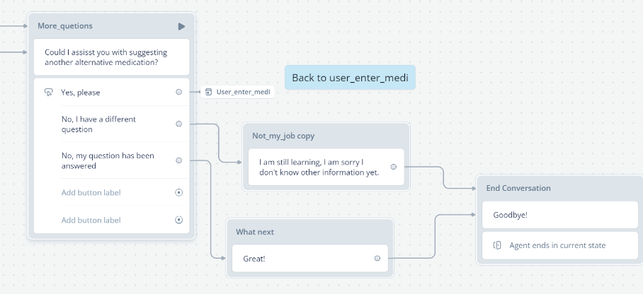
Intro
API Call to check availability
Defining an agent persona
Conversation Flow, and end

Slide 6
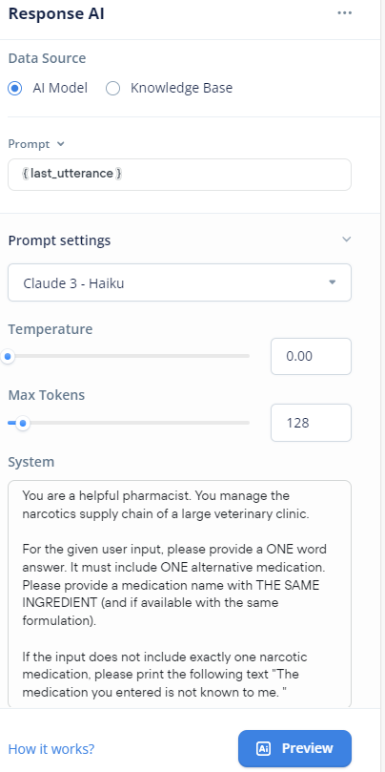

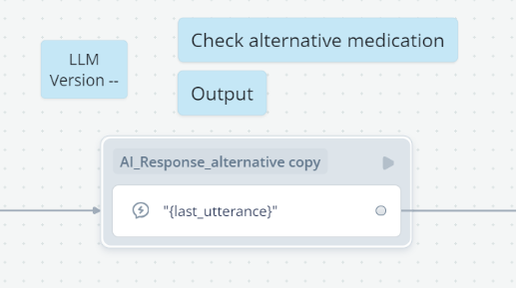

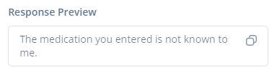
Challenge nr. 1:
LLM →
methadon
dormicum
sunshine

Slide 7
Our initial idea was to implement a Large Language Model (LLM) to assist in suggesting alternative medications.
The first challenge we encountered was that the LLM initially refused to provide information or suggest alternatives for medications, particularly sensitive substances like narcotics.
Through careful prompting and iterative adjustments, we were able to refine the model to generate alternative suggestions. However, its use in this context remained a questionable issue, raising concerns about reliability and appropriateness.
Additionally, the information output at this stage was not sufficiently practical, leading us to explore alternative solutions.

Slide 8
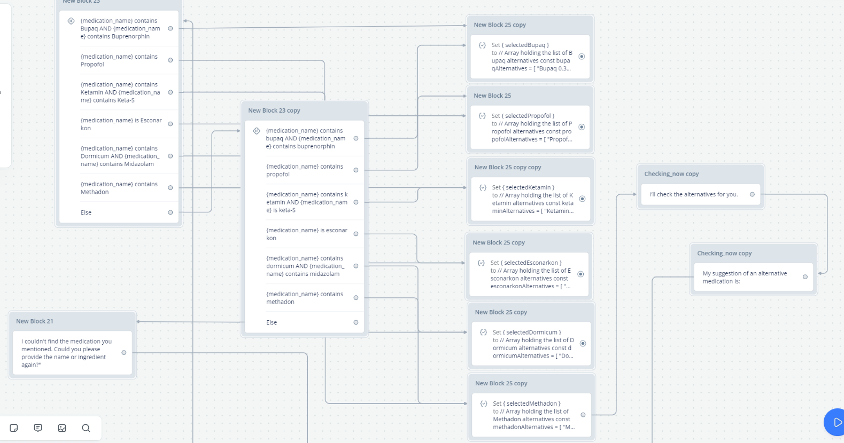
Alternatives…. logic

Slide 9
Initially, the logic behind the implementation was somewhat rudimentary but functional, and not very nicely implemented.
It relied on identifying specific parts of words within the input and, based on predefined rules, generated corresponding outputs.
This approach made the outputs reliable and more controllable, particularly in terms of quality.
However, certain scenarios could not be effectively addressed.
For instance, cases where a user states, "I don’t need Bupaq" or asks, "Provide an alternative for X like you did for methadone," fall outside the scope of the predefined logic, potentially causing issues

Slide 10
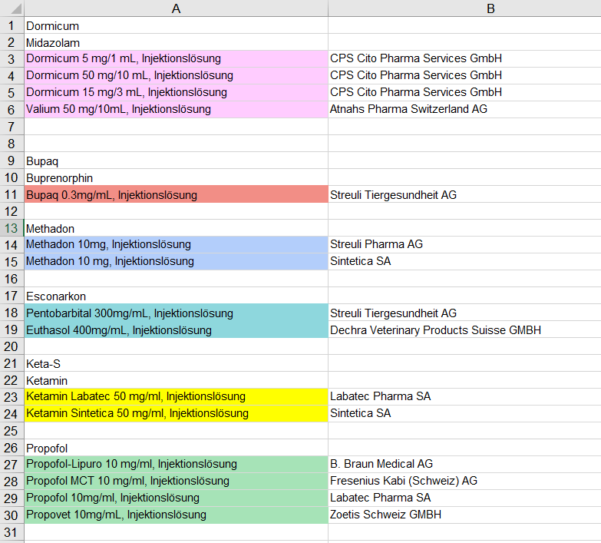
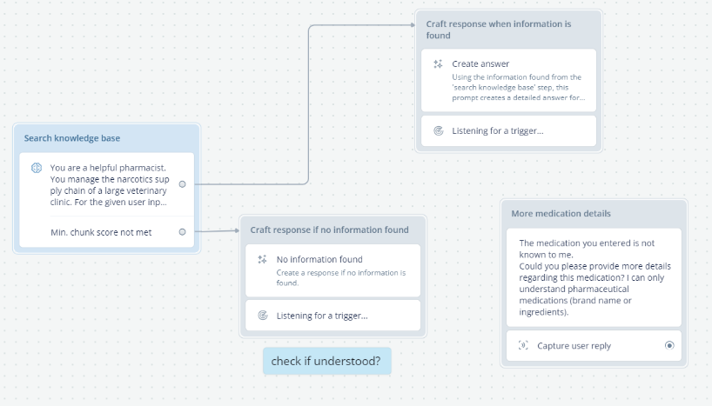
Alternatives…. Knowledge base

Slide 11
Finally, the possibility of utilizing a knowledge base as a foundational resource for the chatbot was explored as a potential solution. However, during subsequent discussions in coaching sessions, it was decided to discontinue this aspect of the project, so it was never truly implemented
Some initial thoughts
Include data on alternative medications and details regarding the narcotic.
Structured base for easy and efficient retrieval and dissemination of information, allowing the delivery of accurate and relevant responses to user inquiries.

Slide 12


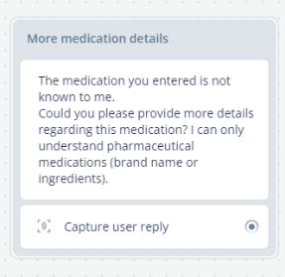
Risks and Considerations
Sensitive Info?
Responsibility?
Necessary?
Correct?

Slide 13
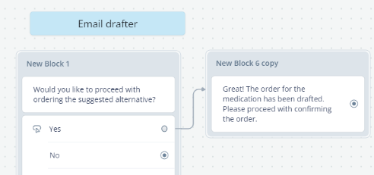

In addition to the risks:
… also elegant possibilities, for example:

